Slide 1


Slide 2

THE IDEAL
Q. HOW IMPORTANT IS OUR HEALTH TO GOD?
A. 3 John :2-Възлюбени, искам повече от всичко да имаш добър успех и да си здрав, както благоуспява душата ти.
The term “even as”, means “just as” thy Soul prospers
God’s Great Desire Cont’

Slide 3

THE IDEAL
Q. How much does God want us to prosper Spiritually?
Matthew 5:48
Jude 24 & 25
Revelation 3:5
God’s Great Desire Cont’

Slide 4
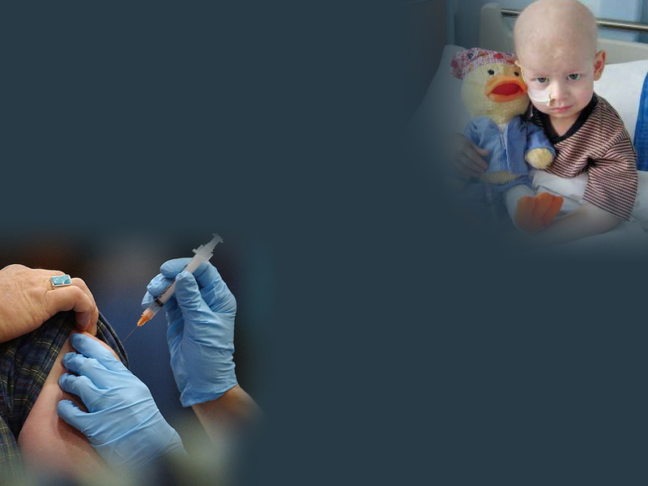
THE REALITY
Q. What will be the condition of the world as it relates to health in the last days?
A. Matthew 24:4-8
Q. How widespread will disease be in the last days?
A. Hosea 3:5/ Hosea 4:1-3
God’s Great Desire Cont’

Slide 5

FIND OUT THE CAUSE
Proverbs 26:2/Job 29:16
Q. What are the reasons for disease?
  SPIRITUAL Numbers 12:5-11
  2 Kings 5:20-27
  John 5:1-8;14
  PHYSICAL Ezekiel 16:49
  Deut 21:20
  Prov. 23:21
  GOD’S OPPORTUNITY John 9:1-3
  TO GLORIFY HIMSELF

Slide 6
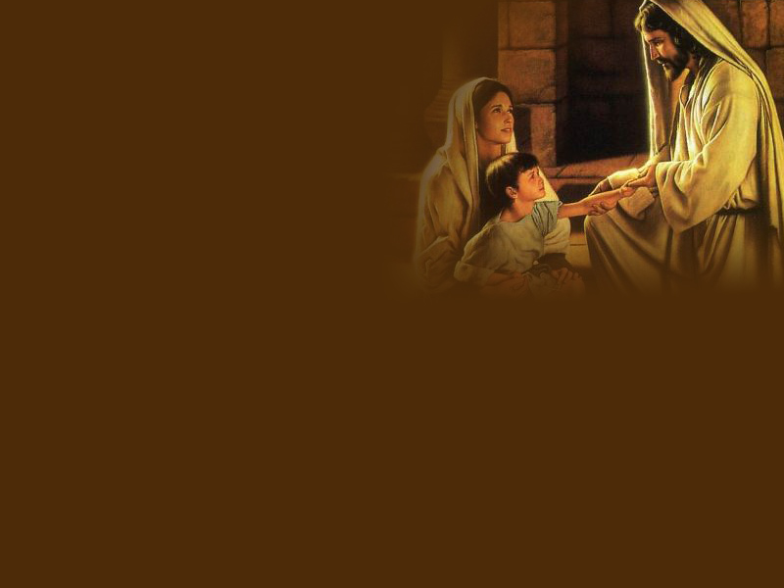
THE SOLUTION
Jeremiah-33:6
  Ето, ще донеса в него здраве и изцеление, и ще ги изцеля, и ще им открия изобилие на мир и истина.
Exodus 15:26
И каза: Ако прилежно слушаш гласа на Господа, твоя Бог, и вършиш онова, което е право пред Него, и слушаш заповедите Му, и пазиш всичките Му повеления, то не ще ти нанеса ни една от тези болести върху тебе, които нанесох върху египтяните, защото Аз съм Господ, Който те изцелявам.

Slide 7
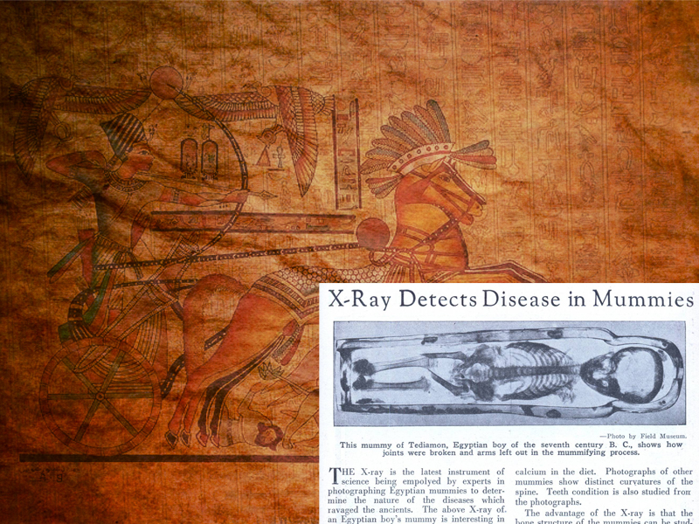
EGYPTIAN DISEASES OF DEUTERONOMY 28
CONSUMPTION
Tuberculosis
Emphysema
FEVER
Chills & Shivering Fits
INFLAMMATION
Arthritis
BOTCH
Chicken Pox, Hives
EMERODS
Tumors, Hemorrhoids
& Cancer

Slide 8

Ten Leading Causes of Death in Romania
Coronary Heart Disease
Stroke
Hypertension
Liver Disease
Lung Cancer
Lung Disease
Colon-Rectum Cancers
Influenza & Pneumonia
Stomach Cancer
Breast Cancer

Slide 9
What is Disease?
Disease is an effort of nature to free the system from conditions that result from a violation of the laws of health. In case of sickness, the cause should be ascertained. Unhealthful conditions should be changed, wrong habits corrected. Then nature is to be assisted in her effort to expel impurities and to re-establish right conditions in the system.
The Ministry of Healing 127.1
Notes:
Violation of the laws of health that governs our bodies.

Slide 10
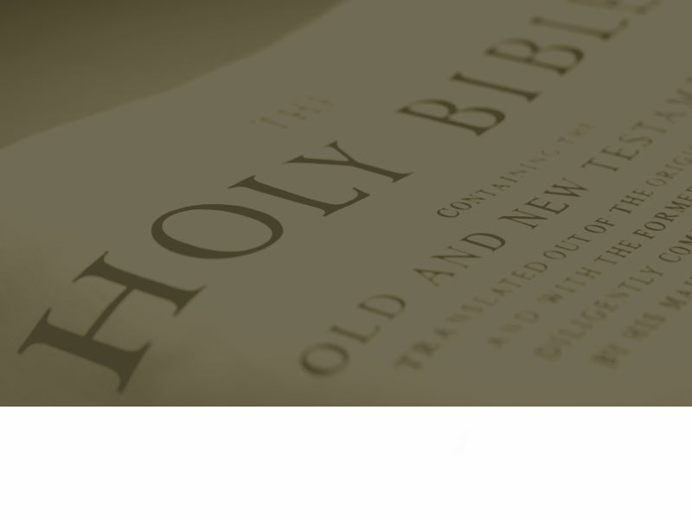

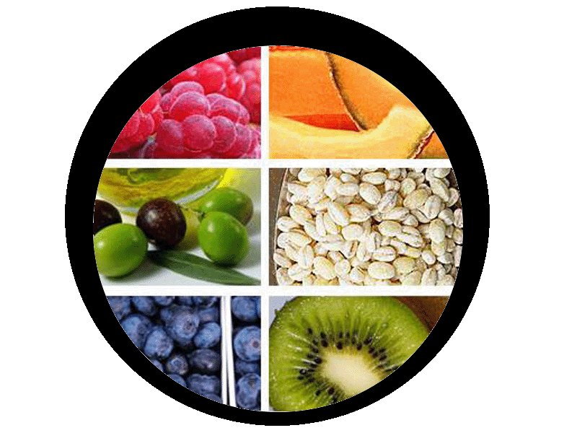

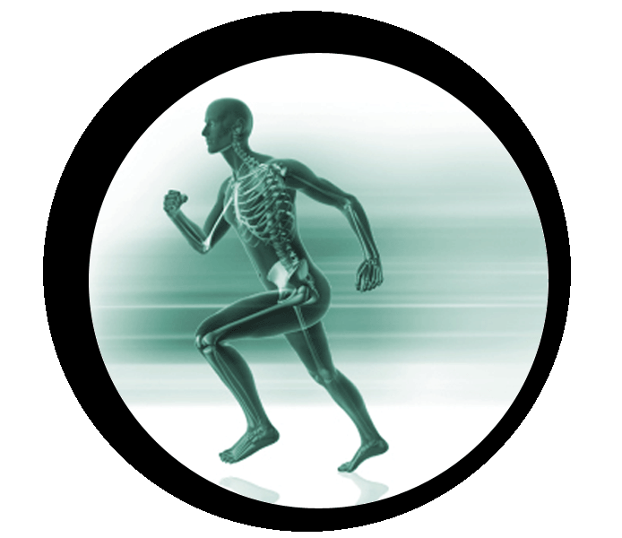
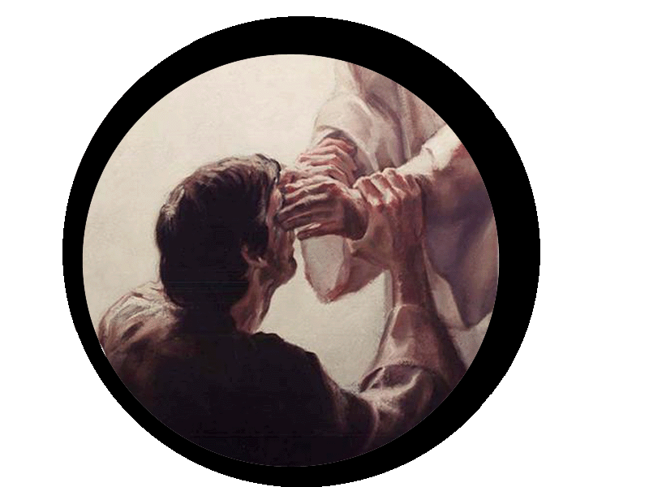

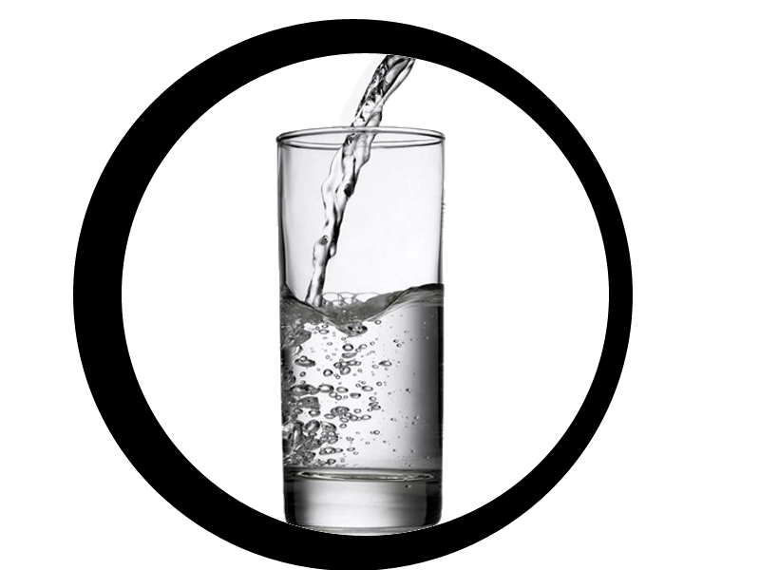






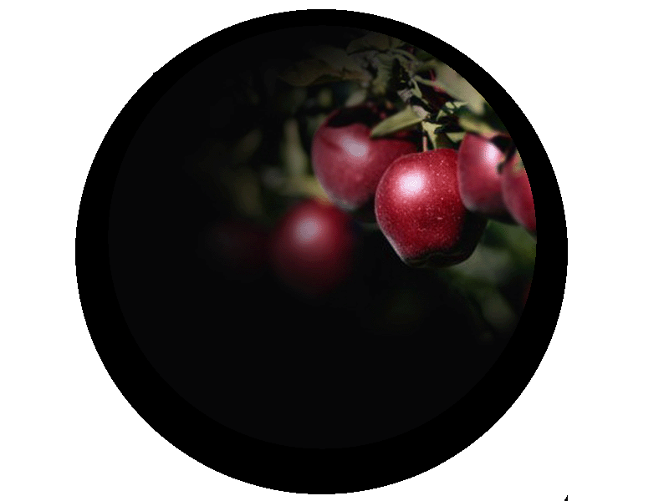


8 LAWS OF HEALTH

Slide 11

THE SOLUTION IN THE CREATION WEEK
Isaiah 45:18
Защото така казва Господ, Който сътвори небето, Тоя Бог, Който създаде земята, направи я, я утвърди, той е създаден не е напразно, но я създаде, за да се населява: Аз съм Господ, и няма друг
God’s Great Desire Cont’

Slide 12

nutrition
Gen 1:29
  ²⁹ И Бог каза: Ето, давам ви всяка семеносна трева, която е по лицето на цялата земя, и всяко дърво, което има в себе си плод на дърво дава семе: те ще ви бъдат за храна..
God’s Great Desire Cont’

Slide 13
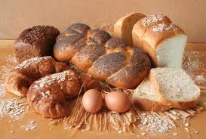
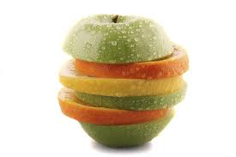
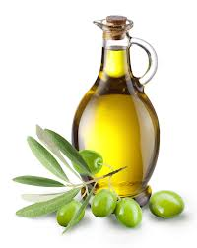
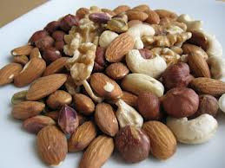
Nutrition
What our body need for proper Nutrition?
Carbohydrates
Proteins
Fats
Vitamins and Minerals
Notes:
Carbohydrates are sources of starches, sugars, and fiber. Starch and sugar are converted into glucose, which is the body’s main fuel. Fiber, found primarily in plant foods, acts as a bulking agent that helps keep the intestines clean.
Proteins are broken down by the body and converted into amino acids, which are the building blocks for hormones, enzymes, and structural components of the body, such as muscle tissue.
Fats are the most concentrated form of energy, supplying over twice as many calories per gram than protein or carbohydrates. It can also be efficiently stored for later use. The three natural types of fats are monounsaturated, polyunsaturated, and saturated. The unsaturated fats are by far the healthiest form, especially when it comes from plant sources. Diets rich in refined saturated fats have been linked with numerous disease.
Vitamins and Minerals are essential components of our diet. Whole foods, which have been refined as little as possible, naturally contain the highest amount of these nutrients. Phytochemicals, found only in plants, are added bonuses thought to play a role in prevention of many diseases.

Slide 14
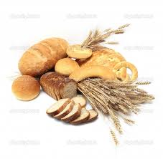
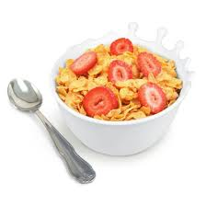
Breads and Cereals
These foods have a high complex carbohydrate content and provide the body with energy sources: whole grain bread, hot cereals, pasta, and brown rice.
Notes:
Five (5) or more servings a day.
Serving size
1/2 cup hot cereal
1 ounce dry cereal
1 slice bread

Slide 15
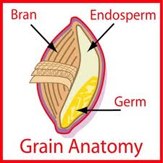
3 Parts of Whole Grain
Notes:
Whole grains are made of all three parts of a grain kernel: the bran, endosperm and germ.
Bran – The coarse, outer layer of the kernel that includes concentrated amounts of several nutrients, including:
Fibre
B vitamins (thiamin, riboflavin, niacin and folic acid)
Minerals (zinc, copper, iron, manganese, magnesium and selenium)
Protein
Phytochemicals (beneficial chemical compounds)
Endosperm – The middle layer (and the largest section) serves as the main energy storehouse for the plant. It contains:
Carbohydrates
Protein
Small amounts of B vitamins
Germ – Although it's the smallest part of the grain, the germ is packed with nutrients. The germ sprouts into a new plant, so it holds rich supplies of the following nutrients:
Minerals
B vitamins
Vitamin E
Phytochemicals (beneficial chemical compounds)
The many health benefits of whole grains come from the whole package, not just the individual parts. The fibre, vitamins, minerals and phytochemicals found in whole grains work together in powerful ways to provide us with energy and good nutrition linked to a host of disease-fighting benefits.
http://www.wholegrainsbureau.ca/about_wg/what_are_wg.html

Slide 16
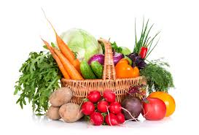
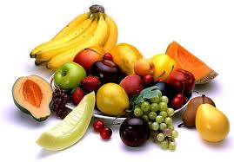
Fruits and Veggies
A diet high in fruits and vegetables has been linked to many health benefits, including:
Healthier body weight
Lower blood pressure
Less risk of diabetes
Certain cancers
Better digestion
Heart health
Clear skin
Shiny hair
Notes:
Two (2) or more servings a day
Serving size:
-1/2 cup cooked beans
-4 ounces tofu
-8 oz. soy milk
Three (3) or more servings a day.
Serving size:
1 cup raw
vegetables
½ cup cooked
vegetables
This group is a primary source of phytochemicals and antioxidants, vitamins and minerals. Sources: for vitamin A, select dark-green, orange or yellow vegetables: for vitamin c, select citrus fruits, strawberries, tomatoes, and potatoes.
Vegetables are often high in vitamins and minerals, according to KidsHealth. Broccoli and green leafy vegetables like spinach and kale are a good source of vitamin K, which is necessary in order for blood to clot properly after injury. Green leafy vegetables are also high in calcium, a mineral necessary for strong bones. Carrots are high in carotenoids, which the body uses to make vitamin A, a necessary nutrient for eye health.

Slide 17
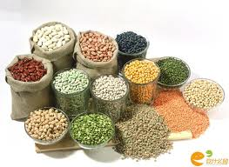
Legumes
Types of legumes include beans, lentils and peanuts. Legumes provide fiber, folate, potassium and iron. Legumes are also recommended as a healthy alternative to animal-derived foods because of its high-protein content.
Notes:
Two (2) or more servings a day
Serving size:
-1/2 cup cooked beans
-4 ounces tofu
-8 oz. soy milk

Slide 18
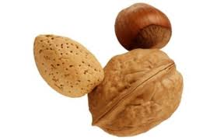
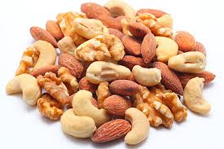
Fats
Those which occur naturally in plant foods. Good whole food sources of fats are whole grains, nuts, beans, seeds, avocados, and olives. If oil is used, less refined and fresher oils(coconut, Grape seed, and olive oil) are better–in small quantities.

Slide 19
Comparison of the 10 Generations before and after the flood
Before Eating Flesh |  | After Eating Flesh
NAME | AGE | NAME | AGE
Adam | 930 | Shem | 600
Seth | 912 | Arphaxad | 438
Enos | 905 | Salah | 433
Cainan | 910 | Eber | 464
Mahalaleel | 895 | Peleg | 239
Jared | 962 | Reu | 239
Enoch | 365 | Serug | 230
Methuselah | 969 | Nahor | 148
Lamech | 777 | Terah | 205
Noah | 950 | Abraham | 175
19

Slide 20

exercise
Gen 2:15
  И Господ Бог взе човека и го засели в Едемската градина, да я обработва и да я пази.
God’s Great Desire Cont’

Slide 21

Exercise
Strengthens the heart
Lowers the blood pressure
Lowers LDL cholesterol and raises HDL
Strengthens bones by helping to retain calcium and minerals
Relieves bad emotions
Promotes blood circulation which also makes the mind clear.

Slide 22
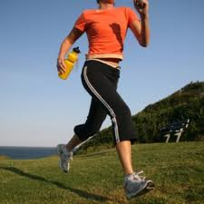

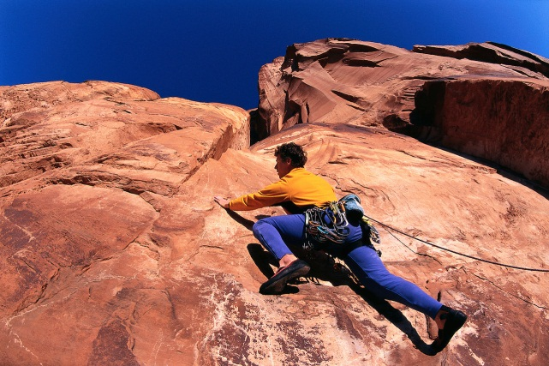
Exercise Prevents
Osteoporosis
Cancer
Diabetes
Arthritis
Cardiovascular

Slide 23
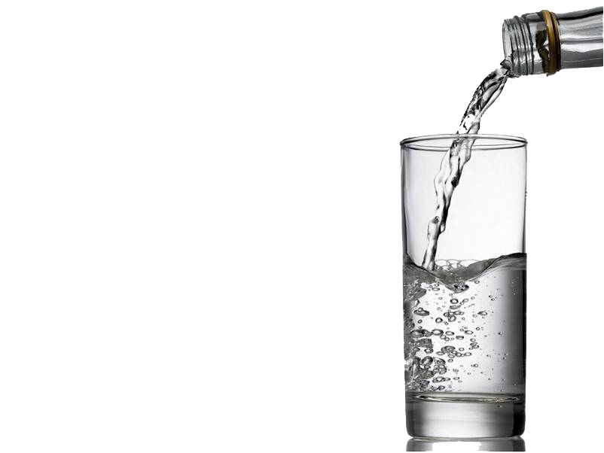
water
Gen 2:10
And a river went out of Eden to water the garden; and from thence it was parted, and became into four heads.
God’s Great Desire Cont’

Slide 24

Water
Body is
70% water
Brain 85%
Blood 83-90%
Bone 22%
Muscles 75%

Slide 25
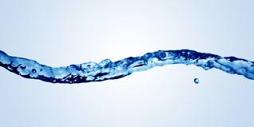
Water
Promotes blood circulation
Lubricates bone joints
Improve the digestion process
Helps Flexibility(muscles, tendon, cartilage, bone)
Keeps body temperature in normal range
Lubricates the eyes
Necessary for production of saliva

Slide 26

sunshine
Gen 1:16
And God made two great lights; the greater light to rule the day, and the lesser light to rule the night: he made the stars also.
Gen 1:17
And God set them in the firmament of the heaven to give light upon the earth,
Gen 1:18
And to rule over the day and over the night, and to divide the light from the darkness: and God saw that it was good.
God’s Great Desire Cont’

Slide 27
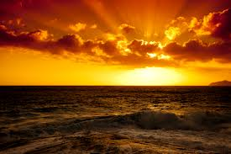
Sunlight
Improves blood circulation
Increases cardiac output
Increases oxygen
Helps regulate blood pressure to healthy level
Increases white blood cells
Lowers cholesterol
Increase the production of serotonin
Notes:
Serotonin is a chemical, produced naturally in your brain and known as a neurotransmitter, that controls communication between brain cells. Serotonin regulates many brain functions that can make you feel good or bad, such as appetite, sleep, memory, and mood. If you do not have enough serotonin, you may feel depressed or anxious. Medications can increase serotonin levels in serious cases, but you can also increase serotonin naturally --- with diet, sunlight, and exercise.
Read more: http://www.livestrong.com/article/132262-natural-ways-get-serotonin/#ixzz2JbgdKrlk

Slide 28


Sunlight
Improves muscle tone and endurance
Increasing body metabolism by stimulating thyroid gland functions
Helps prevent depression and stress
Fights infections and bacteria
Converts cholesterol in the skin to vitamin D
Notes:
Seretonin is converted into melatonin
The thyroid gland controls how quickly the body uses energy, makes proteins, and controls how sensitive the body is to other hormones.

Slide 29

TEMPERANCE
Gen 2:16
  And the LORD God commanded the man, saying, Of every tree of the garden thou mayest freely eat:
Gen 2:17
  But of the tree of the knowledge of good and evil, thou shalt not eat of it: for in the day that thou eatest thereof thou shalt surely die.
God’s Great Desire Cont’

Slide 30

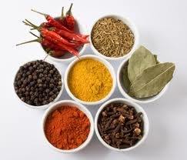
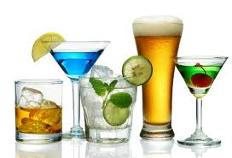

Temperance
Avoid
Tea, coffee, and Colas
Alcohol
Spicy and fermented foods
Refined sugar and junk foods
Drugs and tobacco
Notes:
Temperance is abstaining from anything that is a threat to your body.
Spicy food stimulates the blood and causes hypertension. It also breaks through the mucus walls of the stomach and causes peptic ulcers. Once the stomach walls gets broken through, the stomach acid ends up digesting the stomach thus causing stomach ulcers.

Slide 31
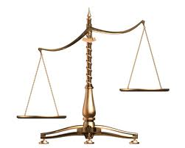
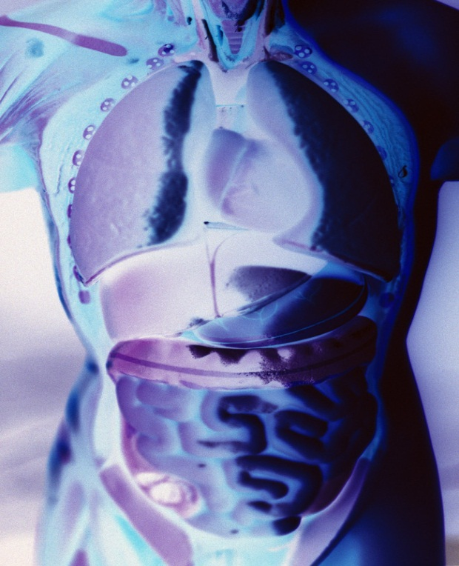
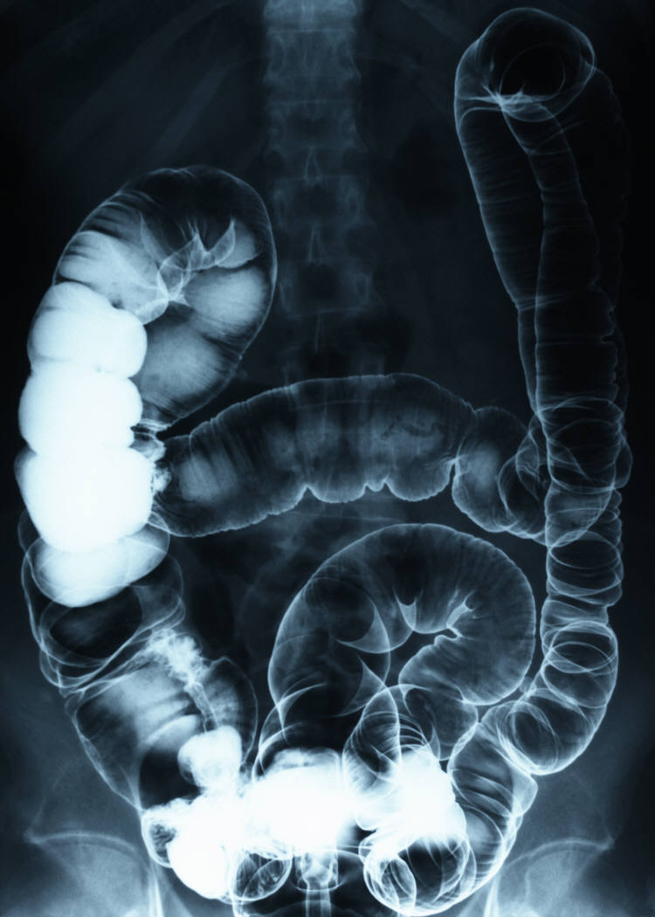
Temperance
Avoid over eating
Have a proper balance of studying and working
Beverages(water) must be consumed 15min before or 1-2 hours after lunch
Avoid snacking/eating in between meals

Slide 32

AIR
Gen 1:6
  And God said, Let there be a firmament in the midst of the waters, and let it divide the waters from the waters.
Gen 1:7
  And God made the firmament, and divided the waters which were under the firmament from the waters which were above the firmament: and it was so.
Gen 1:8
  And God called the firmament Heaven(sky or atmosphere).
  And the evening and the morning
  were the second day.
God’s Great Desire Cont’

Slide 33
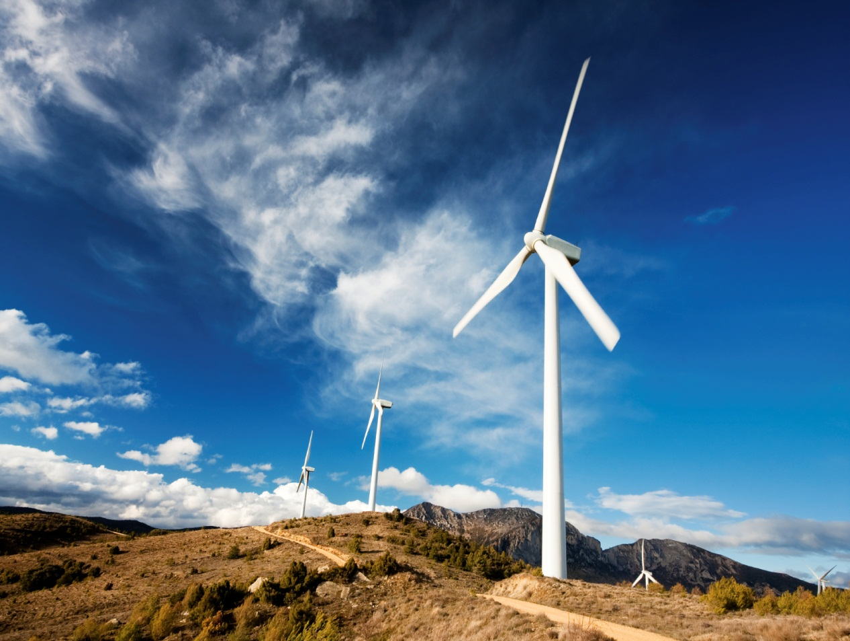
Air
Promotes a healthful circulation of the blood
Refreshes and strengthens the body
Soothes the nerves(gives mind composure and serenity)
Improves digestion
Fresh air in bedroom gives a good night’s sleep
Increases production of endorphins

Slide 34

REST
Gen 2:2
  And on the seventh day God ended his work which he had made; and he rested on the seventh day from all his work which he had made.
Gen 2:3
  And God blessed the seventh day, and sanctified it: because that in it he had rested from all his work which God created and made.
God’s Great Desire Cont’

Slide 35

Rest
Nearly 1/3 of life is spent in sleep. During sleep both the body functions and mental functions are restored. The best quality of sleep is during the hours before midnight preferably no later than 10p.m. We also sleep best if our stomach can also rest from it’s work in digestion.

Slide 36

TRUST IN GOD
Gen 2:17
  But of the tree of the knowledge of good and evil, thou shalt not eat of it: for in the day that thou eatest thereof thou shalt surely die.
Gen 3:4
  And the serpent said unto the woman, Ye shall not surely die:
God’s Great Desire Cont’

Slide 37

Rest
Improves Memory
Improves IQ
Strengthens body’s immune system
Aids in healing of injuries, infections and other assaults on your body
Produces Melatonin
Deep sleep occurs 9pm-12am
Notes:
Promotes the working of Melatonin
-Melatonin is produce in the pineal gland in the response of light that gets into your eyes
Melatonin is the fix and rejuvenate night time hormone
It goes to every cell in your body and cleans out the free radicals and other toxins that are harmful to your cells.
Prevents or helps fight tumors
Slows down the aging process
Boosts immune system
Manages stress
Lower risk of osteoporosis

Slide 38
Benefits of Melatonin
The fix and rejuvenate night time hormone
It goes to every cell in your body and cleans out the free radicals and other toxins that are harmful to your cells.
Prevents or helps fight tumors
Slows down the aging process
Boosts immune system
Manages stress
Lower risk of osteoporosis

Slide 39


Trust in God
When you trust in the Lord wholly(Proverbs 3:5) you’ll be at peace(Isaiah 26:3), therefore your heart will be merry which works in your body as medicine(Proverbs 17:22).
Psalm 103:1-3
Bless the LORD, O my soul: and all that is within me, bless his holy name.
Bless the LORD, O my soul, and forget not all his benefits: Who forgiveth all thine iniquities; who healeth all thy diseases;
Notes:
Proverbs 3:4
Isaiah 26:3
Proverbs 17:22
Proverbs 14:30
Psalms 103:1-3
Exodus 15:26

Slide 40

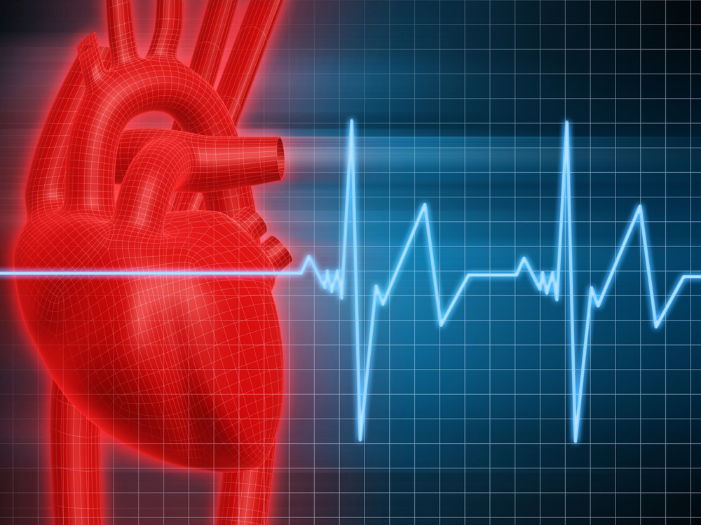
Spiritual Causes
And, behold, they brought to him a man sick of the palsy, lying on a bed: and Jesus seeing their faith said unto the sick of the palsy; Son, be of good cheer; thy sins be forgiven thee. Matthew 9:2
Jesus saith unto him, Rise, take up thy bed, and walk.
And immediately the man was made whole, and took up his bed, and walked: and on the same day was the sabbath.
John 5:6, 9, 14
When Jesus saw him lie, and knew that he had been now a long time in that case, he saith unto him, Wilt thou be made whole?
Aterward Jesus findeth him in the temple, and said unto him, Behold, thou art made whole: sin no more, lest a worse thing come unto thee.
And If thou wilt diligently hearken to the voice of the LORD thy God, and wilt do that which is right in his sight, and wilt give ear to his commandments, and keep all his statutes, I will put none of these diseases upon thee, which I have brought upon the Egyptians: for I am the LORD that healeth thee. Exodus15:26
Notes:
When Jesus saw him lie, and knew that he had been now a long time in that case, he saith unto him, Wilt thou be made whole?
Aterward Jesus findeth him in the temple, and said unto him, Behold, thou art made whole: sin no more, lest a worse thing come unto thee.

Slide 41
Violation of Natural Law
Enervation
Faulty Elimination
Toxemia
Disease Symptoms

Slide 42

WHY IS TAKING CARE OF MY BODY SO IMPORTANT?
1st Thessalonians 5:23
  And the very God of peace sanctify you wholly; and I pray God your whole spirit and soul and body be preserved blameless unto the coming of our Lord Jesus Christ.
God’s Great Desire Cont’

Slide 43

1st Thessalonians 5:23
  And the very God of peace sanctify you wholly; and I pray God your whole spirit and soul and body be preserved blameless unto the coming of our Lord Jesus Christ.

